Slide 1
Cryptography and Network Security
Chapter 2
Fourth Edition
by William Stallings
Edited By Razia Nisar Noorani
Lecture slides by Lawrie Brown
Notes:
Lecture slides by Lawrie Brown for “Cryptography and Network Security”, 4/e, by William Stallings, Chapter 2 – “Classical Encryption Techniques”.

Slide 2
Chapter 2 – Classical Encryption
Techniques
Many savages at the present day regard their names as vital parts of themselves, and therefore take great pains to conceal their real names, lest these should give to evil-disposed persons a handle by which to injure their owners.
—The Golden Bough, Sir James George Frazer
Notes:
Opening quote.

Slide 3
Symmetric Encryption
or conventional / private-key / single-key
sender and recipient share a common key
all classical encryption algorithms are private-key
was only type prior to invention of public-key in 1970’s
and by far most widely used
Notes:
Symmetric encryption, also referred to as conventional encryption or single-key encryption, was the only type of encryption in use prior to the development of public-key encryption in the 1970s. It remains by far the most widely used of the two types of encryption. All traditional schemes are symmetric / single key / private-key encryption algorithms, with a single key, used for both encryption and decryption. Since both sender and receiver are equivalent, either can encrypt or decrypt messages using that common key.

Slide 4
Some Basic Terminology
plaintext - original message
ciphertext - coded message
cipher - algorithm for transforming plaintext to ciphertext
key - info used in cipher known only to sender/receiver
encipher (encrypt) - converting plaintext to ciphertext
decipher (decrypt) - recovering ciphertext from plaintext
cryptography - study of encryption principles/methods
cryptanalysis (codebreaking) - study of principles/ methods of deciphering ciphertext without knowing key
cryptology - field of both cryptography and cryptanalysis
Notes:
Briefly review some terminology used throughout the course.

Slide 5

Symmetric Cipher Model
Notes:
Detail the five ingredients of the symmetric cipher model, shown in Stallings Figure 2.1:
plaintext - original message
encryption algorithm – performs substitutions/transformations on plaintext
secret key – control exact substitutions/transformations used in encryption algorithm
ciphertext - scrambled message
decryption algorithm – inverse of encryption algorithm

Slide 6
Requirements
two requirements for secure use of symmetric encryption:
  a strong encryption algorithm
  a secret key known only to sender / receiver
mathematically have:
  Y = E_{K}(X)
  X = D_{K}(Y)
assume encryption algorithm is known
implies a secure channel to distribute key
Notes:
We assume that it is impractical to decrypt a message on the basis of the cipher- text plus knowledge of the encryption/decryption algorithm, and do not need to keep the algorithm secret; rather we only need to keep the key secret. This feature of symmetric encryption is what makes it feasible for widespread use. It allows easy distribution of s/w and h/w implementations.
Can take a closer look at the essential elements of a symmetric encryption scheme: mathematically it can be considered a pair of functions with: plaintext X, ciphertext Y, key K, encryption algorithm E_{K}, decryption algorithm D_{K}.

Slide 7
Cryptography
characterize cryptographic system by:
  type of encryption operations used
    substitution / transposition / product
  number of keys used
    single-key or private / two-key or public
  way in which plaintext is processed
    block / stream
Notes:
Cryptographic systems can be characterized along these three independent dimensions.

Slide 8
Cryptanalysis
objective to recover key not just message
general approaches:
  cryptanalytic attack
  brute-force attack
Notes:
Typically objective is to recover the key in use rather then simply to recover the plaintext of a single ciphertext.
There are two general approaches:
Cryptanalytic attacks rely on the nature of the algorithm plus perhaps some knowledge of the general characteristics of the plaintext or even some sample plaintext-ciphertext pairs.
Brute-force attacks try every possible key on a piece of ciphertext until an intelligible translation into plaintext is obtained. On average,half of all possible keys must be tried to achieve success.

Slide 9
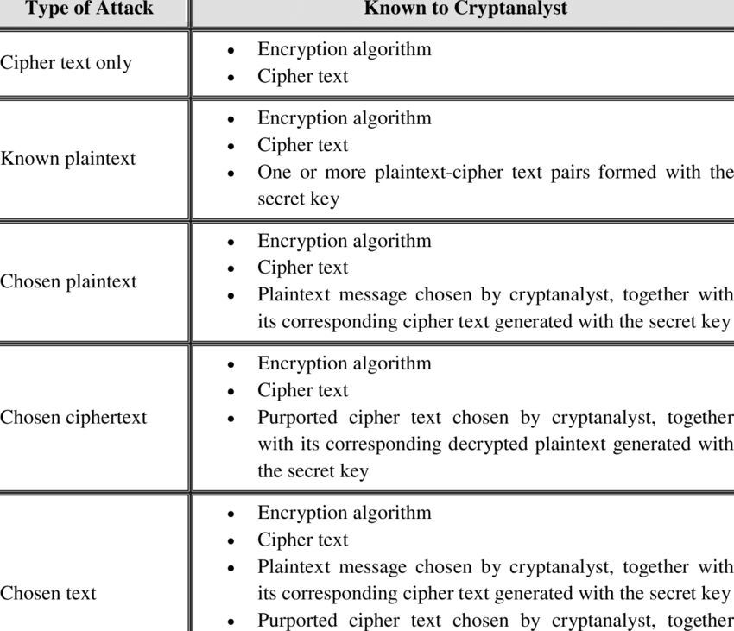

Slide 10
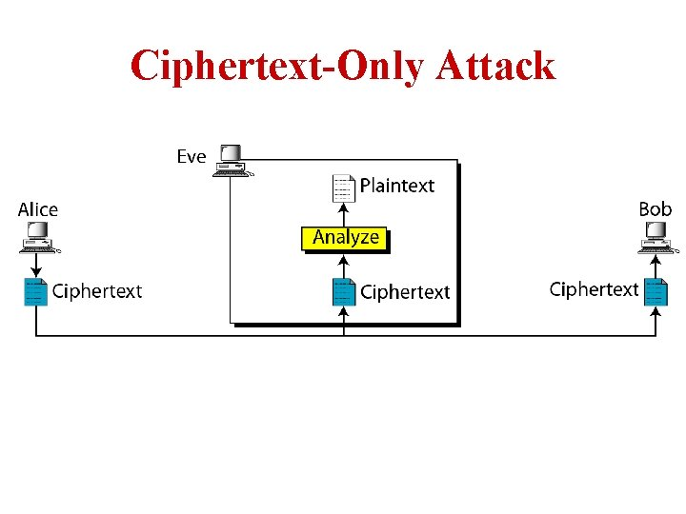
Cryptanalytic Attacks
ciphertext only
  only know algorithm & ciphertext, is statistical, know or can identify plaintext
  In cryptography, a ciphertext-only attack (COA) or known ciphertext attack is an attack model for cryptanalysis where the attacker is assumed to have access only to a set of ciphertexts. The attack is completely successful if the corresponding plaintexts can be deduced (extracted) or, even better, the key.
Notes:
Stallings Table 2.1 summarizes the various types of cryptanalytic attacks, based on the amount of information known to the cryptanalyst, from least to most. The most difficult problem is presented when all that is available is the ciphertext only. In some cases, not even the encryption algorithm is known, but in general we can assume that the opponent does know the algorithm used for encryption. Then with increasing information have the other attacks. Generally, an encryption algorithm is designed to withstand a known-plaintext attack.

Slide 11
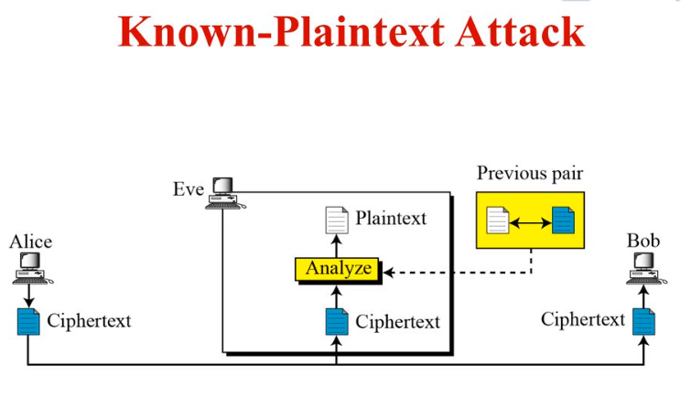
Cryptanalytic Attacks
known plaintext
  know/suspect plaintext & ciphertext

Slide 12
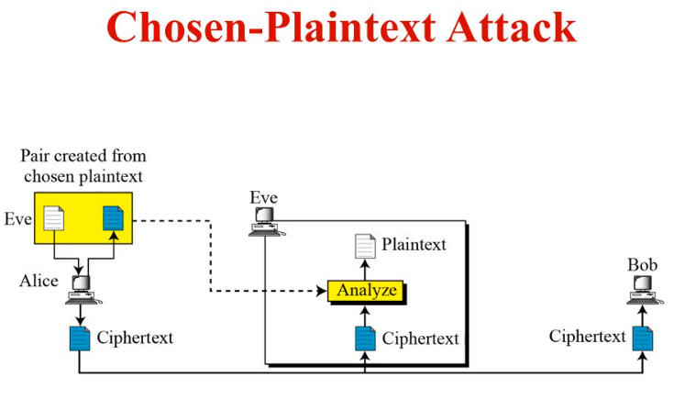
Cryptanalytic Attacks
chosen plaintext
  select plaintext and obtain ciphertext

Slide 13
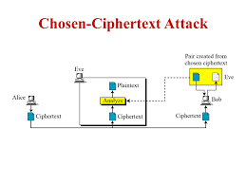
Cryptanalytic Attacks
chosen ciphertext
  select ciphertext and obtain plaintext
  The attacker has capability to make the victim (who obviously knows the secret key) decrypt any ciphertext and send him back the result. ... By analysing the chosen ciphertext and the corresponding received plaintext, the intruder tries to guess the secret key which has been used by the victim.
chosen text
  select plaintext or
  ciphertext to en/decrypt

Slide 14
More Definitions
unconditional security
  no matter how much computer power or time is available, the cipher cannot be broken since the ciphertext provides insufficient information to uniquely determine the corresponding plaintext
computational security
  given limited computing resources (eg time needed for calculations is greater than age of universe), the cipher cannot be broken
Notes:
Two more definitions are worthy of note. An encryption scheme is unconditionally secure if the ciphertext generated by the scheme does not contain enough information to determine uniquely the corresponding plaintext, no matter how much ciphertext is available. An encryption scheme is said to be computationally secure if either the cost of breaking the cipher exceeds the value of the encrypted information, or the time required to break the cipher exceeds the useful lifetime of the information. Unconditional security would be nice, but the only known such cipher is the one-time pad (later).
For all reasonable encryption algorithms, we have to assume computational security where it either takes too long, or is too expensive, to bother breaking the cipher.

Slide 15
Brute Force Search
always possible to simply try every key
most basic attack, proportional to key size
assume either know / recognise plaintext
Key Size (bits) | Number of Alternative Keys | Time required at 1 decryption/µs | Time required at 10⁶ decryptions/µs
32 | 2³² = 4.3 × 10⁹ | 2³¹ µs = 35.8 minutes | 2.15 milliseconds
56 | 2⁵⁶ = 7.2 × 10¹⁶ | 2⁵⁵ µs = 1142 years | 10.01 hours
128 | 2¹²⁸ = 3.4 × 10³⁸ | 2¹²⁷ µs = 5.4 × 10²⁴ years | 5.4 × 10¹⁸ years
168 | 2¹⁶⁸ = 3.7 × 10⁵⁰ | 2¹⁶⁷ µs = 5.9 × 10³⁶ years | 5.9 × 10³⁰ years
26 characters (permutation) | 26! = 4 × 10²⁶ | 2 × 10²⁶ µs = 6.4 × 10¹² years | 6.4 × 10⁶ years
Notes:
A brute-force attack involves trying every possible key until an intelligible translation of the ciphertext into plaintext is obtained. On average, half of all possible keys must be tried to achieve success. Stallings Table 2.2 shows how much time is required to conduct a brute-force attack, for various common key sizes (DES is 56, AES is 128, Triple-DES is 168, plus general mono-alphabetic cipher), where either a single system or a million parallel systems, are used.

Slide 16
Classical Substitution Ciphers
where letters of plaintext are replaced by other letters or by numbers or symbols
or if plaintext is viewed as a sequence of bits, then substitution involves replacing plaintext bit patterns with ciphertext bit patterns
Notes:
In this section and the next, we examine a sampling of what might be called classical encryption techniques. A study of these techniques enables us to illustrate the basic approaches to symmetric encryption used today and the types of cryptanalytic attacks that must be anticipated. The two basic building blocks of all encryption technique are substitution and transposition. We examine these in the next two sections. Finally, we discuss a system that combine both substitution and transposition.

Slide 17
Caesar Cipher
earliest known substitution cipher
by Julius Caesar
first attested use in military affairs
replaces each letter by 3rd letter on
example:
  meet me after the toga party
  PHHW PH DIWHU WKH WRJD SDUWB
Notes:
Substitution ciphers form the first of the fundamental building blocks. The core idea is to replace one basic unit (letter/byte) with another. Whilst the early Greeks described several substitution ciphers, the first attested use in military affairs of one was by Julius Caesar, described by him in Gallic Wars (cf. Kahn pp83-84). Still call any cipher using a simple letter shift a caesar cipher, not just those with shift 3.

Slide 18
Caesar Cipher
can define transformation as:
  a b c d e f g h i j k l m n o p q r s t u v w x y z
  D E F G H I J K L M N O P Q R S T U V W X Y Z A B C
mathematically give each letter a number
  a b c d e f g h i j k l m n o p q r s t u v w x y z
  0 1 2 3 4 5 6 7 8 9 10 11 12 13 14 15 16 17 18 19 20 21 22 23 24 25
then have Caesar cipher as:
  c = E(p) = (p + k) mod (26)
  p = D(c) = (c – k) mod (26)
Notes:
This mathematical description uses modulo (clock) arithmetic. Here, when you reach Z you go back to A and start again. Mod 26 implies that when you reach 26, you use 0 instead (ie the letter after Z, or 25 + 1 goes to A or 0).
Example: howdy (7,14,22,3,24) encrypted using key f (ie a shift of 5) is MTBID

Slide 19
Cryptanalysis of Caesar Cipher
only have 26 possible ciphers
  A maps to A,B,..Z
could simply try each in turn
a brute force search
given ciphertext, just try all shifts of letters
do need to recognize when have plaintext
eg. break ciphertext "GCUA VQ DTGCM"
Notes:
With a caesar cipher, there are only 26 possible keys, of which only 25 are of any use, since mapping A to A etc doesn't really obscure the message! Note this basic rule of cryptanalysis "check to ensure the cipher operator hasn't goofed and sent a plaintext message by mistake"!
Can try each of the keys (shifts) in turn, until can recognise the original message. See Stallings Fig 2.3 for example of search.
Note: as mentioned before, do need to be able to recognise when have an original message (ie is it English or whatever). Usually easy for humans, hard for computers. Though if using say compressed data could be much harder.
Example "GCUA VQ DTGCM" when broken gives "easy to break", with a shift of 2 (key C).

Slide 20
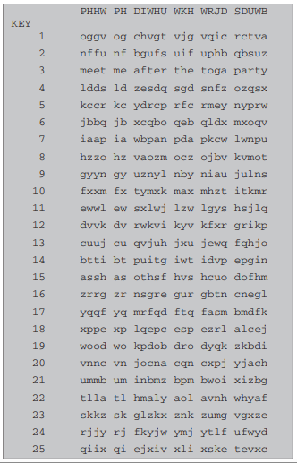
Brute-Force Cryptanalysis of Caesar Cipher

Slide 21
Monoalphabetic Cipher
rather than just shifting the alphabet
could shuffle (jumble) the letters arbitrarily
each plaintext letter maps to a different random ciphertext letter
hence key is 26 letters long
  Plain: abcdefghijklmnopqrstuvwxyz
  Cipher: DKVQFIBJWPESCXHTMYAUOLRGZN
  Plaintext: ifwewishtoreplaceletters
  Ciphertext: WIRFRWAJUHYFTSDVFSFUUFYA
Notes:
With only 25 possible keys, the Caesar cipher is far from secure. A dramatic increase in the key space can be achieved by allowing an arbitrary substitution, where the translation alphabet can be any permutation of the 26 alphabetic characters.
See example translation alphabet, and an encrypted message using it.

Slide 22
Monoalphabetic Cipher Security
now have a total of 26! = 4 x 1026 keys
with so many keys, might think is secure
but would be !!!WRONG!!!
problem is language characteristics
Notes:
Note that even given the very large number of keys, being 10 orders of magnitude greater than the key space for DES, the monoalphabetic substitution cipher is not secure, because it does not sufficiently obscure the underlying language characteristics.

Slide 23
Language Redundancy and Cryptanalysis
human languages are redundant
eg "th lrd s m shphrd shll nt wnt"
letters are not equally commonly used
in English E is by far the most common letter
  followed by T,R,N,I,O,A,S
other letters like Z,J,K,Q,X are fairly rare
have tables of single, double & triple letter frequencies for various languages
Notes:
As the example shows, we don't actually need all the letters in order to understand written English text. Here vowels were removed, but they're not the only redundancy. cf written Hebrew has no vowels for same reason. Are usually familiar with "party conversations", can hear one person speaking out of hubbub of many, again because of redundancy in aural language also. This redundancy is also the reason we can compress text files, the computer can derive a more compact encoding without losing any information. Basic idea is to count the relative frequencies of letters, and note the resulting pattern.

Slide 24

English Letter Frequencies
Notes:
Note that all human languages have varying letter frequencies, though the number of letters and their frequencies varies. Stallings Figure 2.5 shows English letter frequencies. Seberry & Pieprzyk, "Cryptography - An Introduction to Computer Security", Prentice-Hall 1989, Appendix A has letter frequency graphs for 20 languages (most European & Japanese & Malay).

Slide 25
Use in Cryptanalysis
key concept - monoalphabetic substitution ciphers do not change relative letter frequencies
discovered by Arabian scientists in 9th century
calculate letter frequencies for ciphertext
compare counts/plots against known values
if caesar cipher look for common peaks/troughs
  peaks at: A-E-I triple, NO pair, RST triple
  troughs at: JK, X-Z
for monoalphabetic must identify each letter
  tables of common double/triple letters help
Notes:
The simplicity and strength of the monoalphabetic substitution cipher meant it dominated cryptographic use for the first millenium AD. It was broken by Arabic scientists. The earliest known description is in Abu al-Kindi's "A Manuscript on Deciphering Cryptographic Messages", published in the 9th century but only rediscovered in 1987 in Istanbul, but other later works also attest to their knowledge of the field. Monoalphabetic ciphers are easy to break because they reflect the frequency data of the original alphabet. The cryptanalyst looks for a mapping between the observed pattern in the ciphertext, and the known source language letter frequencies. If English, look for peaks at: A-E-I triple, NO pair, RST triple, and troughs at: JK, X-Z.

Slide 26
Example Cryptanalysis
given ciphertext:
  UZQSOVUOHXMOPVGPOZPEVSGZWSZOPFPESXUDBMETSXAIZ
  VUEPHZHMDZSHZOWSFPAPPDTSVPQUZWYMXUZUHSX
  EPYEPOPDZSZUFPOMBZWPFUPZHMDJUDTMOHMQ
count relative letter frequencies (see text)
guess P & Z are e and t
guess ZW is th and hence ZWP is the
proceeding with trial and error finally get:
  it was disclosed yesterday that several informal but
  direct contacts have been made with political
  representatives of the viet cong in moscow
Notes:
Illustrate the process with this example from the text in Stallings section 2.2.

Slide 27
Playfair Cipher
not even the large number of keys in a monoalphabetic cipher provides security
one approach to improving security was to encrypt multiple letters
the Playfair Cipher is an example
invented by Charles Wheatstone in 1854, but named after his friend Baron Playfair
Notes:
Consider ways to reduce the "spikyness" of natural language text, since if just map one letter always to another, the frequency distribution is just shuffled. One approach is to encrypt more than one letter at once. The Playfair cipher is an example of doing this.

Slide 28
Playfair Key Matrix
a 5X5 matrix of letters based on a keyword
fill in letters of keyword (sans duplicates)
fill rest of matrix with other letters
eg. using the keyword MONARCHY
M | O | N | A | R
C | H | Y | B | D
E | F | G | I/J | K
L | P | Q | S | T
U | V | W | X | Z
Notes:
The best-known multiple-letter encryption cipher is the Playfair, which treats digrams in the plaintext as single units and translates these units into ciphertext digrams. The Playfair algorithm is based on the use of a 5x5 matrix of letters constructed using a keyword. The rules for filling in this 5x5 matrix are: L to R, top to bottom, first with keyword after duplicate letters have been removed, and then with the remain letters, with I/J used as a single letter. This example comes from Dorothy Sayer's book "Have His Carcase", in which Lord Peter Wimsey solves it, and describes the use of a probably word attack.

Slide 29
Encryption Using Playfair
plaintext is encrypted two letters at a time
  if a pair is a repeated letter, insert filler like 'X’
  if both letters fall in the same row, replace each with letter to their immediate right if the original pair is on the right side of the row then wrapping around to the left side of the row happens.
  if both letters fall in the same column, replace each with the letter immidietly below it, if the original pair is at the botton of the row than again wrapping to top from bottom happens.
  If the alphabets are not in the same row or column replace them with the alphabets in the same row respectively. But at the other pair of the rectangle defined by the original pair.
Notes:
Plaintext is encrypted two letters at a time,according to the rules as shown. Note how you wrap from right side back to left, or from bottom back to top.
if a pair is a repeated letter, insert a filler like 'X', eg. "balloon" encrypts as "ba lx lo on"
if both letters fall in the same row, replace each with letter to right (wrapping back to start from end), eg. “ar" encrypts as "RM"
if both letters fall in the same column, replace each with the letter below it (again wrapping to top from bottom), eg. “mu" encrypts to "CM"
otherwise each letter is replaced by the one in its row in the column of the other letter of the pair, eg. “hs" encrypts to "BP", and “ea" to "IM" or "JM" (as desired)
Decrypting of course works exactly in reverse. Can see this by working the example pairs shown, backwards.

Slide 30
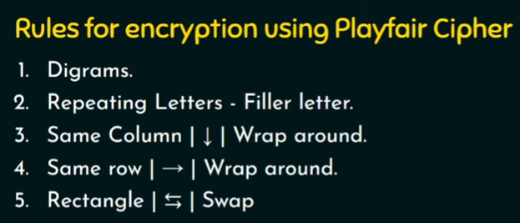

Slide 31
Decryption using playfair.
If both the letters are in the same row: Take the letter to the left of each one (going back to the rightmost if at the leftmost position).
If both the letters are in the same column: Take the letter above each one (going back to the bottom if at the top).
If neither of the above rules is true: Form a rectangle with the two letters and take the letters on the horizontal opposite corner of the rectangle.

Slide 32
Lets Solve
Message = MY NAME IS ATUL
Keyword= PLAYFAIR EXAMPLE
Encrypt the message with the keyword using Play fair substitution Cipher.

Slide 33
Security of Playfair Cipher
security much improved over monoalphabetic
since have 26 x 26 = 676 digrams
would need a 676 entry frequency table to analyse (verses 26 for a monoalphabetic)
and correspondingly more ciphertext
was widely used for many years
  eg. by US & British military in WW1
it can be broken, given a few hundred letters
since still has much of plaintext structure
Notes:
The Playfair cipher is a great advance over simple monoalphabetic ciphers, since there are 26*26=676 digrams (vs 26 letters), so that identification of individual digrams is more difficult. Also,the relative frequencies of individual letters exhibit a much greater range than that of digrams, making frequency analysis much more difficult. The Playfair cipher was for a long time considered unbreakable. It was used as the standard field system by the British Army in World War I and still enjoyed considerable use by the U.S.Army and other Allied forces during World War II. Despite this level of confidence in its security,the Playfair cipher is relatively easy to break because it still leaves much of the structure of the plaintext language intact

Slide 34
Polyalphabetic Ciphers
polyalphabetic substitution ciphers
Improve on mono alphabatic cipher
improve security using multiple cipher alphabets
make cryptanalysis harder with more alphabets to guess and flatter frequency distribution
use a key to select which alphabet is used for each letter of the message
use each alphabet in turn
repeat from start after end of key is reached
Notes:
One approach to reducing the "spikyness" of natural language text is used the Playfair cipher which encrypts more than one letter at once. We now consider the other alternative, using multiple cipher alphabets in turn. This gives the attacker more work, since many alphabets need to be guessed, and because the frequency distribution is more complex, since the same plaintext letter could be replaced by several ciphertext letters, depending on which alphabet is used. The general name for this approach is a polyalphabetic substitution cipher. All these techniques have the following features in common:
A set of related monoalphabetic substitution rules is used.
2. A key determines which particular rule is chosen for a given transformation.

Slide 35
Vigenère Cipher
simplest polyalphabetic substitution cipher
effectively multiple caesar ciphers
Ci=( Pi+ Ki) mod 26
key is multiple letters long K = k₁ k₂ ... k_{d}
i^{th} letter specifies i^{th} alphabet to use
use each alphabet in turn
repeat from start after d letters in message
decryption simply works in reverse
Notes:
The best known, and one of the simplest, such algorithms is referred to as the Vigenère cipher, where the set of related monoalphabetic substitution rules consists of the 26 Caesar ciphers, with shifts of 0 through 25. Each cipher is denoted by a key letter, which is the ciphertext letter that substitutes for the plaintext letter ‘a’, and which are each used in turn, as shown next.

Slide 36
Example of Vigenère Cipher
write the plaintext out
write the keyword repeated above it
use each key letter as a caesar cipher key
encrypt the corresponding plaintext letter
eg using keyword deceptive
  key: deceptivedeceptivedeceptive
  plaintext: wearediscoveredsaveyourself
  ciphertext:ZICVTWQNGRZGVTWAVZHCQYGLMGJ
Notes:
Discuss this simple example from text Stallings section 2.2.

Slide 37
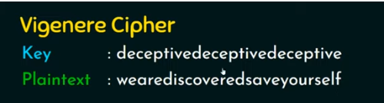
Example

Slide 38
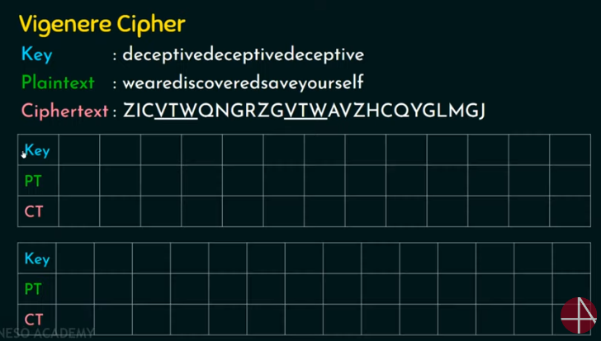

Slide 39
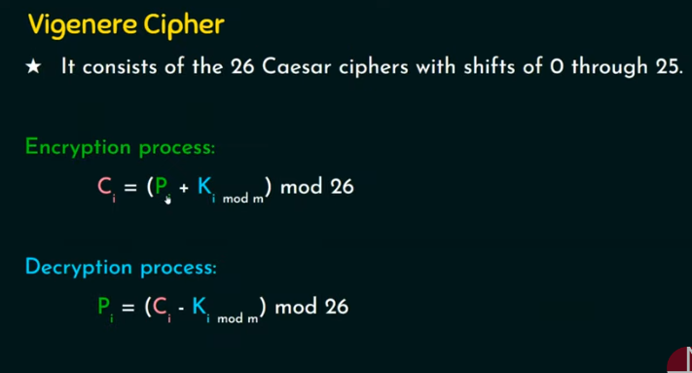

Slide 40
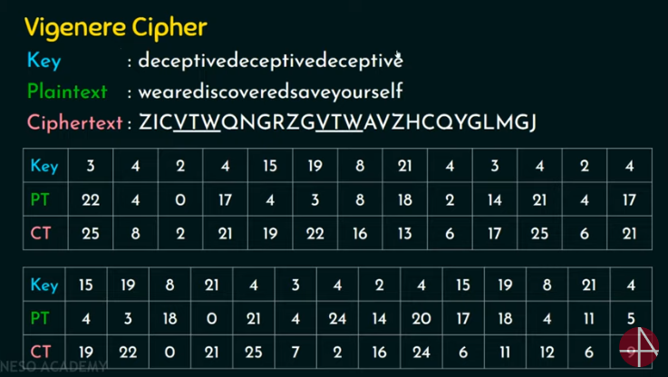

Slide 41
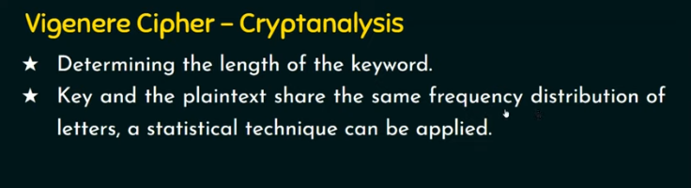

Slide 42
Aids
simple aids can assist with en/decryption
a Saint-Cyr Slide is a simple manual aid
  a slide with repeated alphabet
  line up plaintext 'A' with key letter, eg 'C'
  then read off any mapping for key letter
can bend round into a cipher disk
or expand into a Vigenère Tableau
Notes:
Implementing polyalphabetic ciphers by hand can be very tedious. Various aids were devised to assist the process.
The "Saint-Cyr Slide" was popularised and named by Jean Kerckhoffs, who published a famous early text "La Cryptographie Militaire" (Miltary Cryptography) in 1883. He named the slide after the French National Military Academy where the methods were taught. He also noted that any slide can be expanded into a tableau, or bent round into a cipher disk.
The Vigenère Tableau (given in the text as Stallings Table 2.3) is a complete set of forward shifted alphabet mappings.

Slide 43
Security of Vigenère Ciphers
have multiple ciphertext letters for each plaintext letter
hence letter frequencies are obscured
but not totally lost
start with letter frequencies
  see if look monoalphabetic or not
if not, then need to determine number of alphabets, since then can attach each
Notes:
The Vigenère & related polyalphabetic ciphers still do not completely obscure the underlying language characteristics.
The key to breaking them was to identify the number of translation alphabets, and then attack each separately.

Slide 44
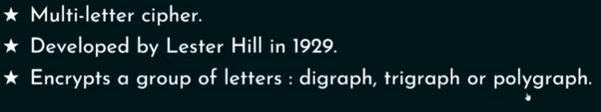
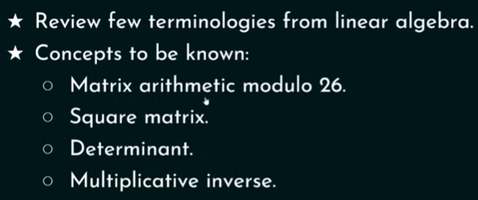
Hill Cipher

Slide 45
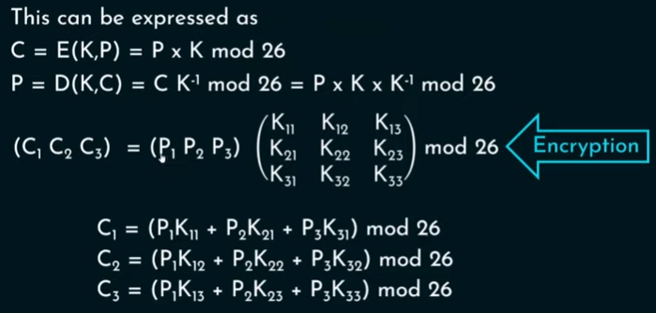
Hill Cipher

Slide 46
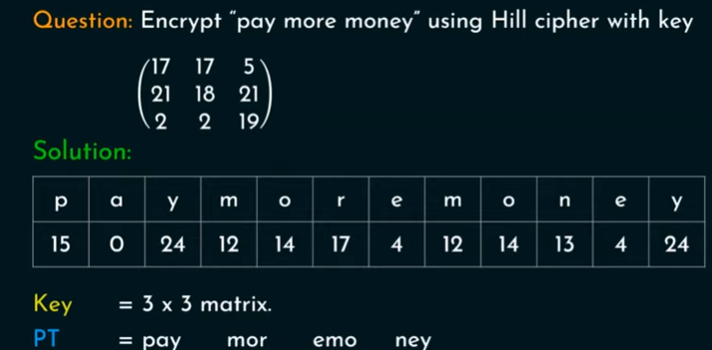
Hill Cipher

Slide 47
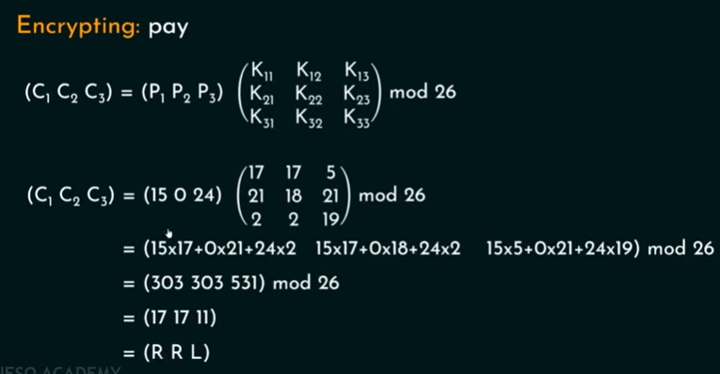
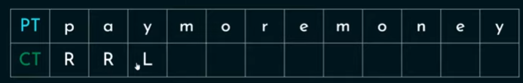
Hill Cipher

Slide 48
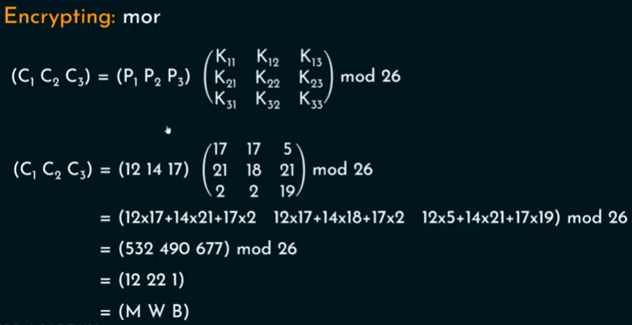
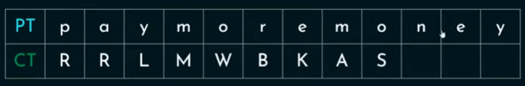

Slide 49
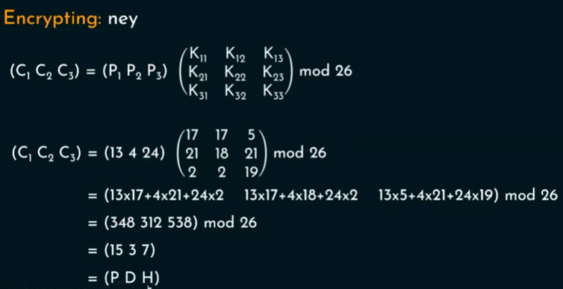
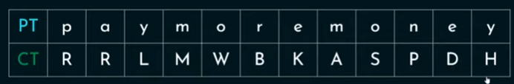

Slide 50
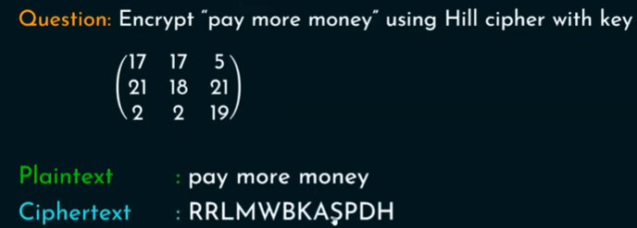
Hill Cipher

Slide 51
Kasiski Method
method developed by Babbage / Kasiski
repetitions in ciphertext give clues to period
so find same plaintext an exact period apart
which results in the same ciphertext
of course, could also be random fluke
eg repeated “VTW” in previous example
suggests size of 3 or 9
then attack each monoalphabetic cipher individually using same techniques as before
Notes:
For some centuries the Vigenère cipher was le chiffre indéchiffrable (the unbreakable cipher). As a result of a challenge, it was broken by Charles Babbage (the inventor of the computer) in 1854 but kept secret (possibly because of the Crimean War - not the first time governments have kept advances to themselves!). The method was independently reinvented by a Prussian, Friedrich Kasiski, who published the attack now named after him in 1863. However lack of major advances meant that various polyalphabetic substitution ciphers were used into the 20C. One very famous incident was the breaking of the Zimmermann telegram in WW1 which resulted in the USA entering the war.
In general the approach is to find a number of duplicated sequences, collect all their distances apart, look for common factors, remembering that some will be random flukes and need to be discarded. Now have a series of monoalphabetic ciphers, each with original language letter frequency characteristics. Can attack these in turn to break the cipher.

Slide 52
Autokey Cipher
ideally want a key as long as the message
Vigenère proposed the autokey cipher
with keyword is prefixed to message as key
knowing keyword can recover the first few letters
use these in turn on the rest of the message
but still have frequency characteristics to attack
eg. given key deceptive
  key: deceptivewearediscoveredsav
  plaintext: wearediscoveredsaveyourself
  ciphertext:ZICVTWQNGKZEIIGASXSTSLVVWLA
Notes:
Taking the polyalphabetic idea to the extreme, want as many different translation alphabets as letters in the message being sent. One way of doing this with a smallish key, is to use the Autokey cipher.
The example uses the keyword "DECEPTIVE" prefixed to as much of the message "WEAREDISCOVEREDSAV" as is needed. When deciphering, recover the first 9 letters using the keyword "DECEPTIVE". Then instead of repeating the keyword, start using the recovered letters from the message "WEAREDISC". As recover more letters, have more of key to recover later letters.
Problem is that the same language characteristics are used by the key as the message. ie. a key of 'E' will be used more often than a 'T' etc hence an 'E' encrypted with a key of 'E' occurs with probability (0.1275)2 = 0.01663, about twice as often as a 'T' encrypted with a key of 'T' have to use a larger frequency table, but it exists given sufficient ciphertext this can be broken.

Slide 53
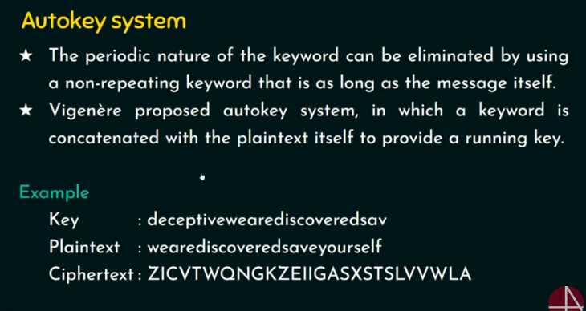

Slide 54
One-Time Pad
Also called Vernam Cipher
if a truly random key as long as the message is used, the cipher will be secure
called a One-Time pad
is unbreakable since ciphertext bears no statistical relationship to the plaintext
since for any plaintext & any ciphertext there exists a key mapping one to other
can only use the key once though
problems in generation & safe distribution of key
Notes:
The One-Time Pad is an evolution of the Vernham cipher, which was invented by Gilbert Vernham in 1918, and used a long tape of random letters to encrypt the message. An Army Signal Corp officer, Joseph Mauborgne, proposed an improvement using a random key that was truly as long as the message, with no repetitions, which thus totally obscures the original message. It produces random output that bears no statistical relationship to the plaintext. Because the ciphertext contains no information whatsoever about the plaintext, there is simply no way to break the code, since any plaintext can be mapped to any ciphertext given some key.
The one-time pad offers complete security but, in practice, has two fundamental difficulties:
There is the practical problem of making large quantities of random keys.
2. And the problem of key distribution and protection, where for every message to be sent, a key of equal length is needed by both sender and receiver.
Because of these difficulties, the one-time pad is of limited utility, and is useful primarily for low-bandwidth channels requiring very high security.

Slide 55
Transposition Ciphers
now consider classical transposition or permutation ciphers
these hide the message by rearranging the letter order
without altering the actual letters used
can recognise these since have the same frequency distribution as the original text
Notes:
All the techniques examined so far involve the substitution of a ciphertext symbol for a plaintext symbol. A very different kind of mapping is achieved by performing some sort of permutation on the plaintext letters. This technique is referred to as a transposition cipher, and form the second basic building block of ciphers. The core idea is to rearrange the order of basic units (letters/bytes/bits) without altering their actual values.

Slide 56
Rail Fence cipher
write message letters out diagonally over a number of rows
then read off cipher row by row
eg. write message out as:
  m e m a t r h t g p r y
  e t e f e t e o a a t
giving ciphertext
  MEMATRHTGPRYETEFETEOAAT
Notes:
The simplest such cipher is the rail fence technique, in which the plaintext is written down as a sequence of diagonals and then read off as a sequence of rows.
The example message is: "meet me after the toga party" with a rail fence of depth 2.
This sort of thing would be trivial to cryptanalyze.

Slide 57
Row Transposition Ciphers
a more complex transposition
Also called simple columnar
write letters of message out in rows over a specified number of columns
then reorder the columns according to some key before reading off the rows
  Key: 3 4 2 1 5 6 7
  Plaintext: a t t a c k p
  o s t p o n e
  d u n t i l t
  w o a m x y z
  Ciphertext: TTNAAPTMTSUOAODWCOIXKNLYPETZ
Notes:
A more complex transposition cipher is to write the message in a rectangle, row by row, and read the message off shuffling the order of the columns in each row.
A pure transposition cipher is easily recognized because it has the same letter frequencies as the original plaintext. For the type of columnar transposition just shown, cryptanalysis is fairly straightforward and involves laying out the ciphertext in a matrix and playing around with column positions. Digram and trigram frequency tables can be useful.

Slide 58
Product Ciphers
ciphers using substitutions or transpositions are not secure because of language characteristics
hence consider using several ciphers in succession to make harder, but:
  two substitutions make a more complex substitution
  two transpositions make more complex transposition
  but a substitution followed by a transposition makes a new much harder cipher
this is bridge from classical to modern ciphers
Notes:
Have seen that ciphers based on just substitutions or transpositions are not secure, and can be attacked because they do not sufficient obscure the underlying language structure
So consider using several ciphers in succession to make harder.
A substitution followed by a transposition is known as a Product Cipher, and makes a new much more secure cipher, and forms the bridge to modern ciphers.

Slide 59
Rotor Machines
before modern ciphers, rotor machines were most common complex ciphers in use
widely used in WW2
  German Enigma, Allied Hagelin, Japanese Purple
implemented a very complex, varying substitution cipher
used a series of cylinders, each giving one substitution, which rotated and changed after each letter was encrypted
with 3 cylinders have 26³=17576 alphabets
Notes:
The next major advance in ciphers required use of mechanical cipher machines which enabled to use of complex varying substitutions.
A rotor machine consists of a set of independently rotating cylinders through which electrical pulses can flow. Each cylinder has 26 input pins and 26 output pins, with internal wiring that connects each input pin to a unique output pin. If we associate each input and output pin with a letter of the alphabet, then a single cylinder defines a monoalphabetic substitution. After each input key is depressed, the cylinder rotates one position, so that the internal connections are shifted accordingly. The power of the rotor machine is in the use of multiple cylinders, in which the output pins of one cylinder are connected to the input pins of the next, and with the cylinders rotating like an “odometer”, leading to a very large number of substitution alphabets being used, eg with 3 cylinders have 26³=17576 alphabets used.
They were extensively used in world war 2, and the history of their use and analysis is one of the great stories from WW2.

Slide 60

Hagelin Rotor Machine
Notes:
This photo of an Allied Hagelin machine was taken by Lawrie Brown at Eurocrypt'93 in Norway. Note pen for scale, and the rotating cipher wheels near the front.

Slide 61
Steganography
an alternative to encryption
hides existence of message
  using only a subset of letters/words in a longer message marked in some way
  using invisible ink
  hiding in LSB in graphic image or sound file
has drawbacks
  high overhead to hide relatively few info bits
Notes:
Steganography is an alternative to encryption which hides the very existence of a message by some means. There are a large range of techniques for doing this.
Steganography has a number of drawbacks when compared to encryption. It requires a lot of overhead to hide a relatively few bits of information.
Also, once the system is discovered, it becomes virtually worthless, although a message can be first encrypted and then hidden using steganography.

Slide 62
Summary
have considered:
  classical cipher techniques and terminology
  monoalphabetic substitution ciphers
  cryptanalysis using letter frequencies
  Playfair cipher
  polyalphabetic ciphers
  transposition ciphers
  product ciphers and rotor machines
  stenography
Notes:
Chapter 2 summary.

